Slide 1


Machine Learning Data Platform
Overview of the Machine Learning Data Platform (MLDP) with focus on the Data Platform (DP) subsystem (previously “Datastore”)
Christopher K. Allen
Craig McChesney

Slide 2
Motivation
Full-stack support for machine learning and general data science applications in large particle accelerator and experimental physics facilities.
From high-speed data acquisition to rapid ML/AI application development and deployment.
Provide a “data-science ready” host platform for building artificial intelligence, machine learning, and general data science applications for the diagnosis, modeling, control, and optimization of these facilities.
A standardized platform for rapid implementation and deployment of ML/Data Science algorithms to different operating configurations and different facilities.
Data science perspective of archived facility data.

Slide 3
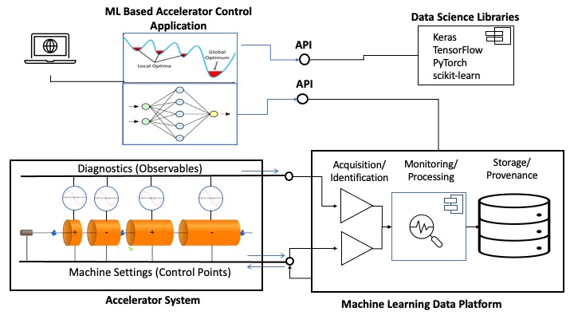
MLDP Concept
The Machine Learning Data Platform (MLDP) has 3 primary functions:
High-speed data acquisition (EPICS).
Archiving, processing, and management of heterogeneous, time-correlated data.
Data Analysis: Broad search and query, annotation, and processing of archive. (data science/ML/AI applications)
Function are realized by separate subsystems each supporting a category of use cases.
Conceptual diagram of Machine Learning Data Platform

Slide 4
MLDP Background
MLDP development is supported by the US Dept. of Energy (DOE) under a Small Business Innovative Research (SBIR) grant starting in 2022.
A prototype MLDP was completed in Phase I with the following subsystems:
Aggregator – EPICS based, high-speed synchronous data acquisition of heterogeneous data.
Datastore – Standalone system for data ingestion, archive management and access.
Web Application – Universal, remote access and interaction with data archive.
SBIR Phase II awarded in 2023 (Fiscal Year 2024)
Redesign of Datastore archive and services with emphasis on performance (Year 1).
Support for full archive annotation (Year 1).
Datastore use case expansions (Year 2)
Datastream processing,
Algorithm Plugins,
Advanced Data Science Applications.
“Data Platform” (DP) references previous “Datastore” system of prototype MLDP.
Includes upgrades and extensions for Phase II project.

Slide 5
Organization/Outline
Overview of the MLDP - “The Big Picture”
Subsystems
Aggregator
Data Platform
Web Application
Project Status
Data Platform (DP) as standalone system
Architecture
Component Use Cases
Data Archive
DP Communications
gRPC Interface
API Language Libraries
DP Deployment
Summary

Slide 6

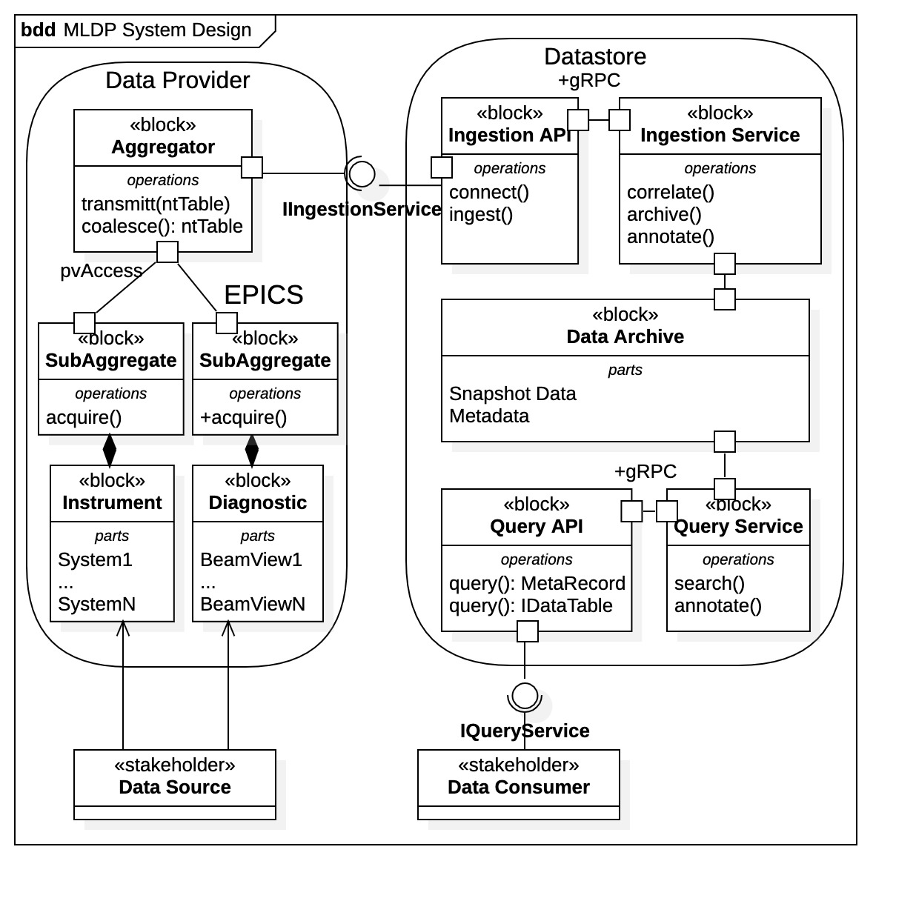
Terminology
Data Source – generic term for time-series data source
Associated with data acquisition.
hardware, process variables, FPGA, etc.
Data Provider – generic collection of data sources.
Associated with data ingestion - Any source of heterogeneous, time-series data.
Example - MLDP Aggregator subsystem
Any actor conforming to Ingestion API
Data Consumer – consumer of MLDP data.
Engineer, data scientist, application, datastream plugin, etc.
Snapshot Data – heterogeneous, correlated, time-series data.
Time-series data is captured as “snapshots” within data archive.
Metadata – characteristics of snapshot data.
Used for provenance, event reconstruction, archive annotation, etc.
MLDP block diagram with subsystems, components, and stakeholders

Slide 7
Overview Machine Learning Data Platform (MLDP)
Subsystems and Deployment
Subsystem Overview
Data Archive
Aggregator
Data Platform
Web Service
Project Status

Slide 8
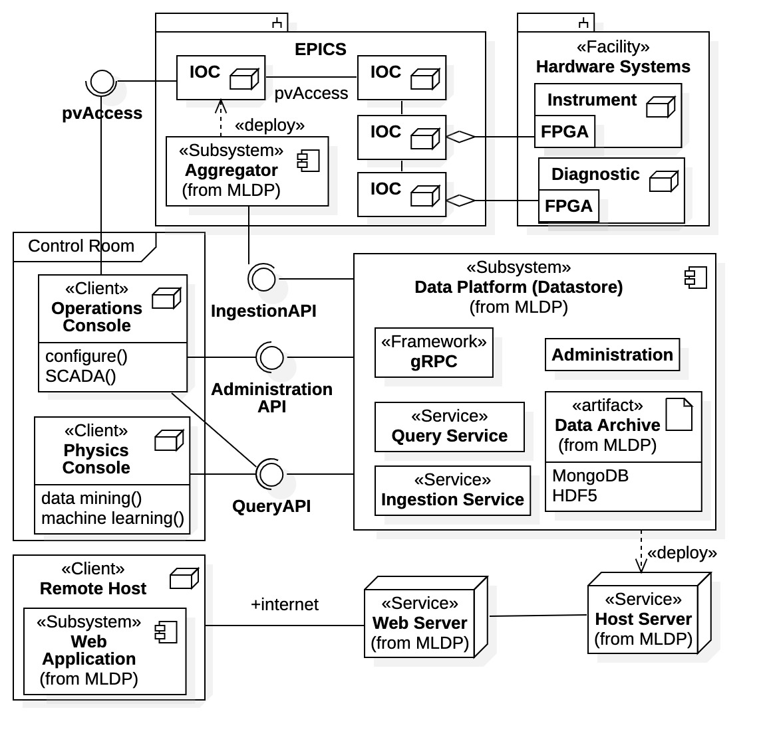
MLDP Overview MLDP Subsystems/Deployment
Aggregator (a Data Provider)
High-speed data acquisition and collection of facility hardware data.
Deployed with EPICS control system.
Data Platform (previously Datastore)
Standalone – deployed on separate server(s), EPICS not required.
Any facility may use data platform.
Contains the Data Archive.
Composed of collaborating services.
Independent gRPC comm. framework.
Well-defined APIs for communication.
Web Application provides remote access to Data Archive using an internet web browser.
Attaches to the Data Platform subsystem.
Machine Learning Data Platform subsystems and deployment

Slide 9
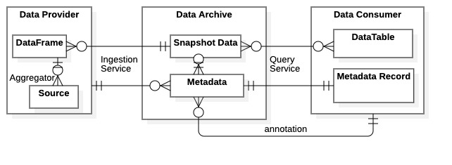
MLDP Overview MLDP Data Archive
Data Archive contains
Snapshot Data – Heterogenous, correlated, time-series device data.
Flows in as Data Frames (NTTables) .
Flows out as dynamic Data Tables.
Metadata – Characteristics/associations/properties within snapshot data.
Created by Ingestion Service and augmented by Query Service.
Flows out as Metadata Records.
Annotations – User additions to data archive (notes, relations, calculations).
Created by Data Consumers as “value-added” data.
Flows out as Metadata Records.
NOTE: The MLDP data archive is maintained completely by the Data Platform subsystem.
MLDP data flow diagram

Slide 10
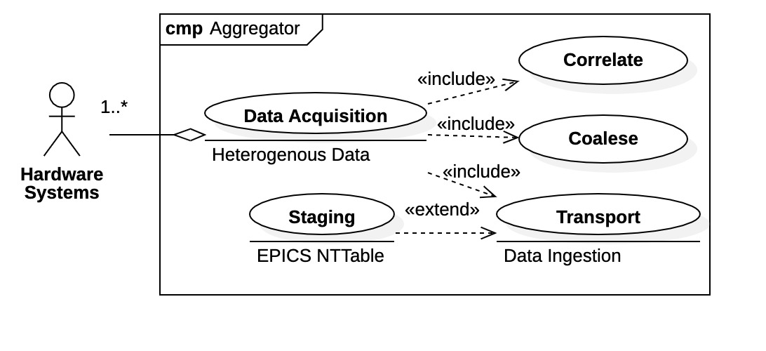
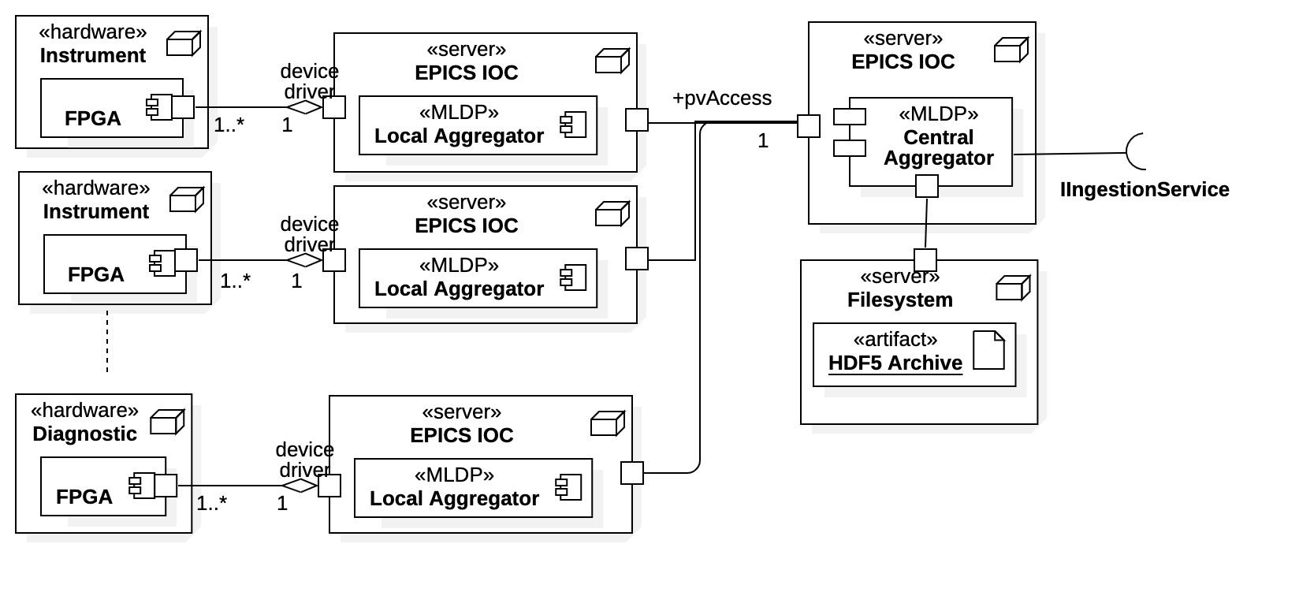
MLDP Overview Aggregator Subsystem
Clients here are hardware systems
Aggregator performs synchronous, high-speed data acquisition and collection within EPICS control system.
Aggregator use cases
Distributed system
Local Aggregators – proximal to hardware
Collect and align local hetero data.
May have multiple data sources.
Transport to Central Aggregator.
Central Aggregator
Coalesce all aggregated data.
Stage as NTTable “snapshots”.
Transport to Data Platform via API.
Aggregator system architecture

Slide 11
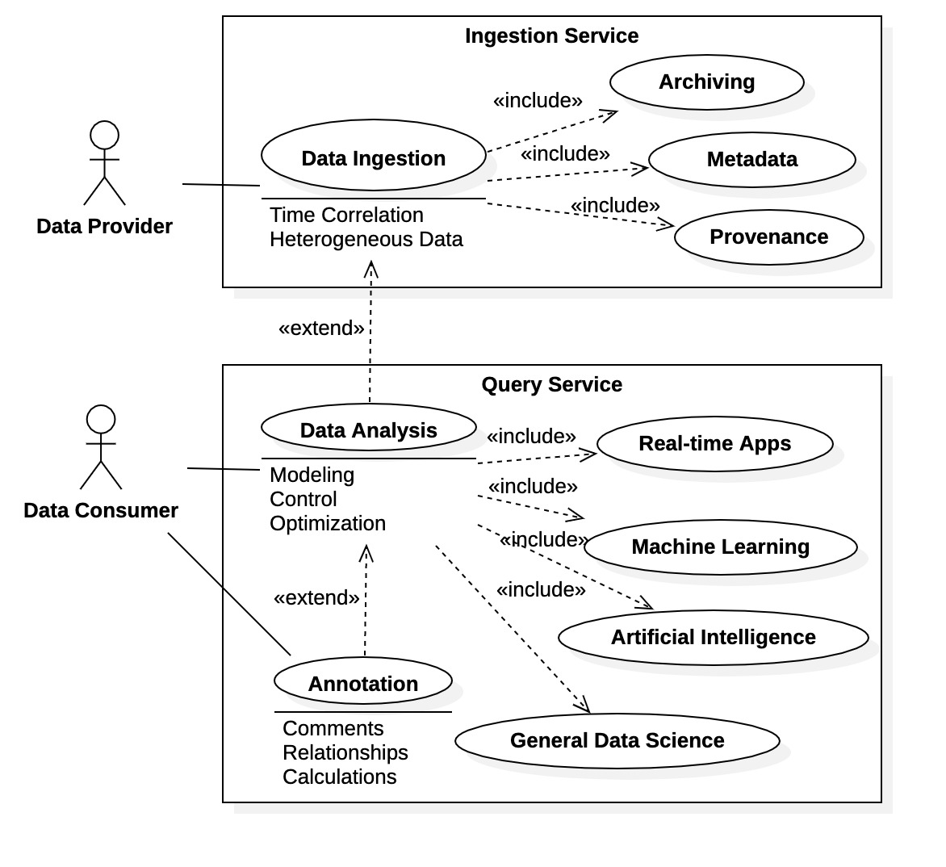
MLDP Overview Data Platform (Datastore)
Clients are generically divided into Data Providers - populate data archive Data Consumers - utilize data archive
The Data Platform (formerly Datastore) manages the data archive and is the primary interaction point for data scientists.
A standalone system.
Independent of EPICS
RPC-based communications framework (gRPC).
Fundamental components implemented as services
Ingestion Service – clients are Data Providers that supply data to the archive.
Query Service – clients are Data Consumers that interact with archive data (and metadata)
Engineers, data scientists, physicists, applications, remote users, etc.
Data Platform use cases as seen by clients

Slide 12
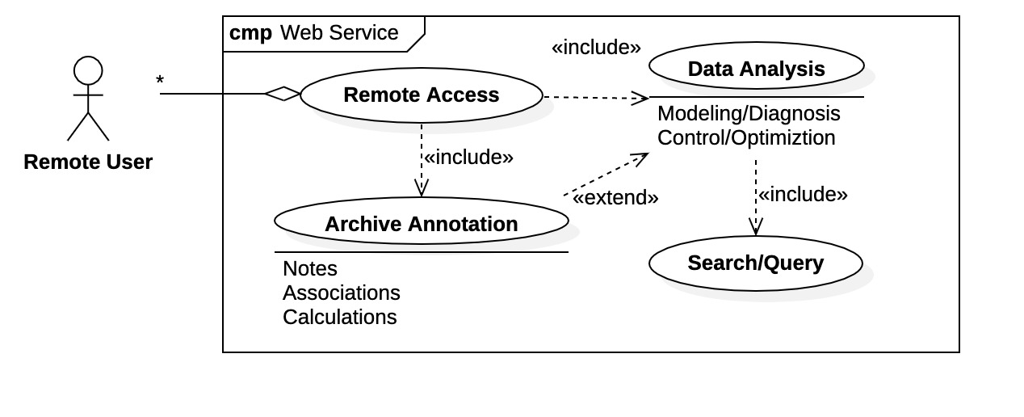
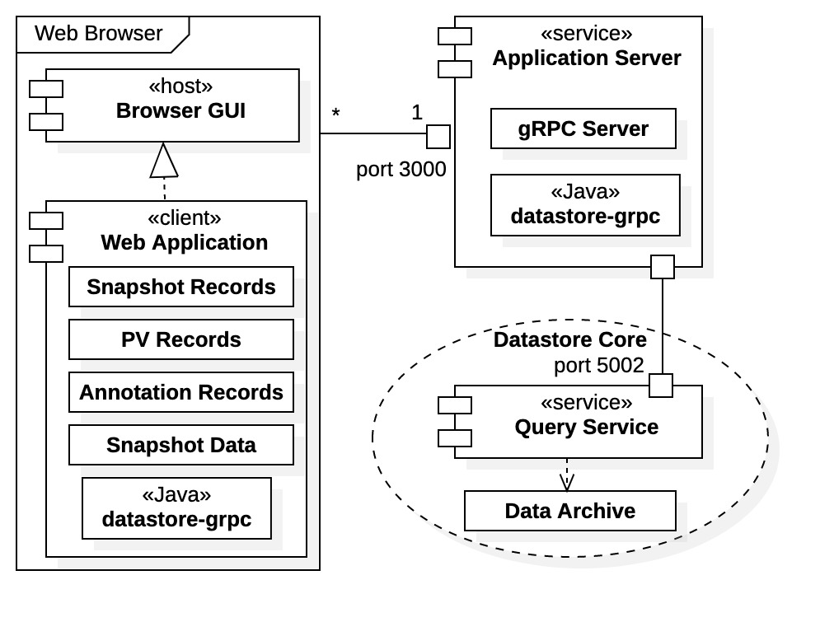
MLDP Overview Web Service and Web Application
Web Application/Web Service use cases
Web Application is a remote application deployed to web browsers by the DP Web Service (Application Server).
Web Application deployed upon initial browser connection, then
Web Service manages communications between Web Application and Data Platform.
Web Application provides remote access to the DP data archive.
Facilitates a subset of Query Service use cases.
Tools for inspection, visualization, downloads, and some data analysis.
Web Application/Web Service architecture

Slide 13

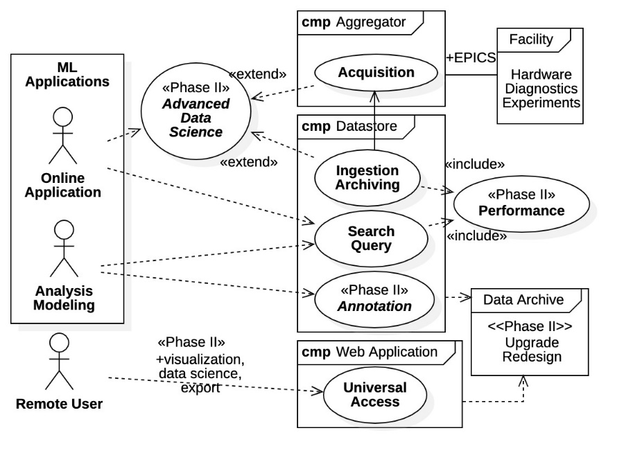
MLDP Project Status
A prototype of the MLDP was developed in Phase I.
Proof of principle – Rapid development required extensive use of 3rd party systems and technologies.
Extensive performance and operation evaluations.
Aggregator system is mature – built in-house using only EPICS technologies.
Completed - Redesign of Data Platform archive and core services
Eliminated many 3rd party systems – now restricted to Java, gRPC, and MongoDB.
gRPC communications framework redesigned and operational.
Evaluation of C++ gRPC for datastream processing (~ 500 Mbps transmission rates).
Integrated deployment systems (operational but incomplete).
New Ingestion Service operational (basic functionality).
New Query Service (basic functionality) is near completion.
Performance improvements
Ingestion over 200x faster than prototype at ~ 200 Mbps data archiving rates.
Current Activities (Year 1)
API language library development (Java and Python).
Migrating/expanding existing prototype libraries to new architecture.
Enhanced Query Service architecture (distributed client/service processing).
Annotation Service is next priority.
Future Activities (Year 2)
Web Application refactoring and extensions (ongoing).
Datastream processing architecture.
SBIR Phase II activities

Slide 14
Project Status Evaluations and benchmarking for DP
Benchmark Description | Data Rates
 | Double Values (vals/sec) | Bytes (bytes/sec)
gRPC network transmission (Java) | 22M – 33M | 176M – 264M
Archiving, structured - HDF5 large | 68M – 77M | 544M – 616M
Archiving, structured - JSON files | 38M – 47M | 304M – 376M
Archiving, buckets - MongoDB | 7M – 11M | 56M – 88M
Archiving, buckets - MariaDB | 4.5M – 5.5M | 36M – 44M
Archiving, structured - HDF5 small | 1.3M – 2.4M | 10.4M – 19.2M
Archiving, points - InfluxDB | 750K – 940K | 6M – 7.52M
Archiving, points - MongoDB | 360K – 410K | 2.88M – 3.28M
Archiving, points - MariaDB | 140K – 162K | 1.12M – 1.3M
Metadata updates - MongoDB | 11K to 36K updates/sec | -
Redesign of Data Platform required extensive testing and benchmarking of existing technologies and methods.
Performance
Modularity/dependencies
Development effort
Ease of deployment
Final design decisions for Data Platform
Java – development/performance/deploy
gRPC – standalone comm. framework
MongoDB – both time-series and metadata
HDF5* – reserved for legacy data/performance
Data Platform component evaluation and benchmarking

Slide 15
Data Platform Data Platform as a Standalone system
Basic Architecture
Services based
Use Cases
Use cases supported by each service.
Communications
Direct gRPC interface
Language libraries (Java and Python APIs)
Installation and Deployment
NOTE: Again, the Data Platform is currently under development.
Development and support for the Datastore prototype has been suspended.

Slide 16
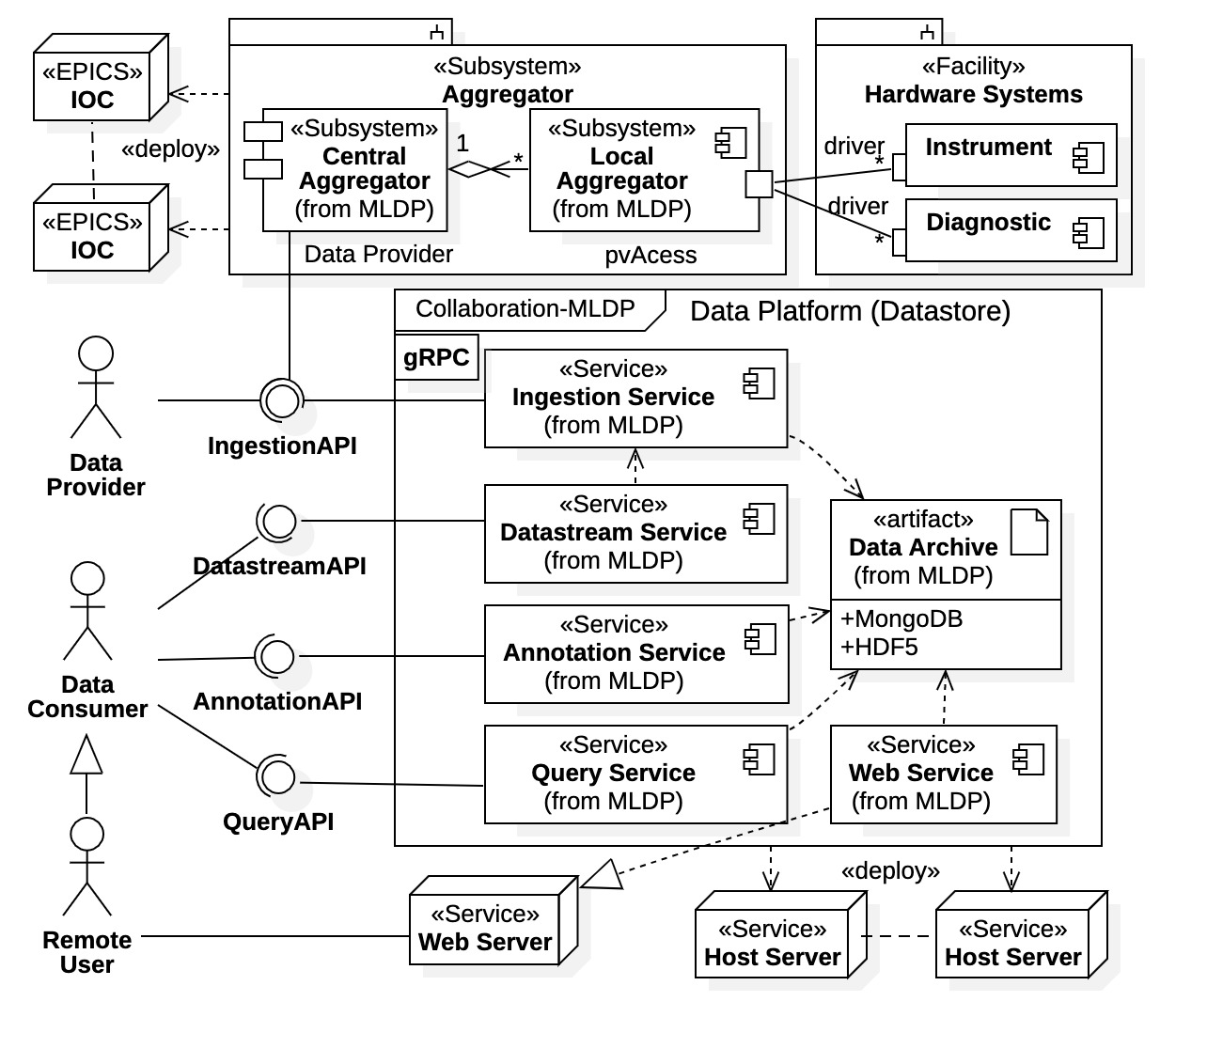
Data Platform Architecture and Deployment
A closer look at DP architecture and components.
Recall clients are Data Providers and Data Consumers
Separate DP components implemented as services supporting various client use cases.
Ingestion Service supports all Data Provider use cases (e.g., Aggregator).
“Query Service” has subcomponents
Query Service (proper) – archive search/query
Annotation Service – post-ingestion annotation
Datastream Service –real-time data processing
Web Service – remote archive access
Data Platform composite diagram with client relationships

Slide 17
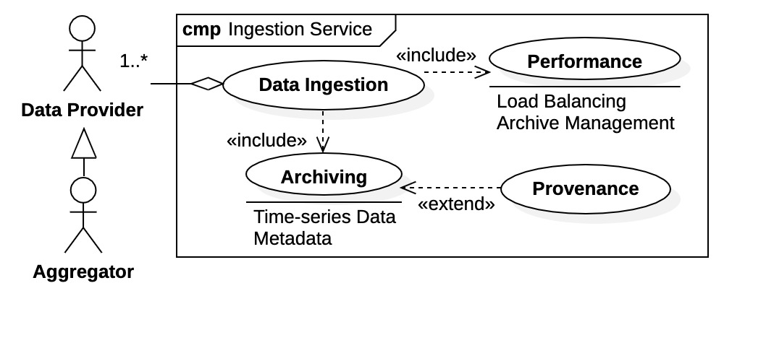
Data Platform Data Ingestion Use Cases
Data Ingestion by the Data Platform (DP Archive population)
Ingestion Service supports Data Ingestion use case.
Clients are Data Providers.
Any Data Provider conforming to Ingestion API can populate DP archive.
The Aggregator subsystem is one Data Provider.
Ingestion Service interface
Direct gRPC communications
Java language API library based upon NTTable ingestion
NOTE: The Ingestion Service supports the Data Platform is a standalone system.
After DP archive is populated via Ingestion Service, all backend MLDP use cases and services are available to Data Consumers.
Ingestion Service internal use case breakdown

Slide 18
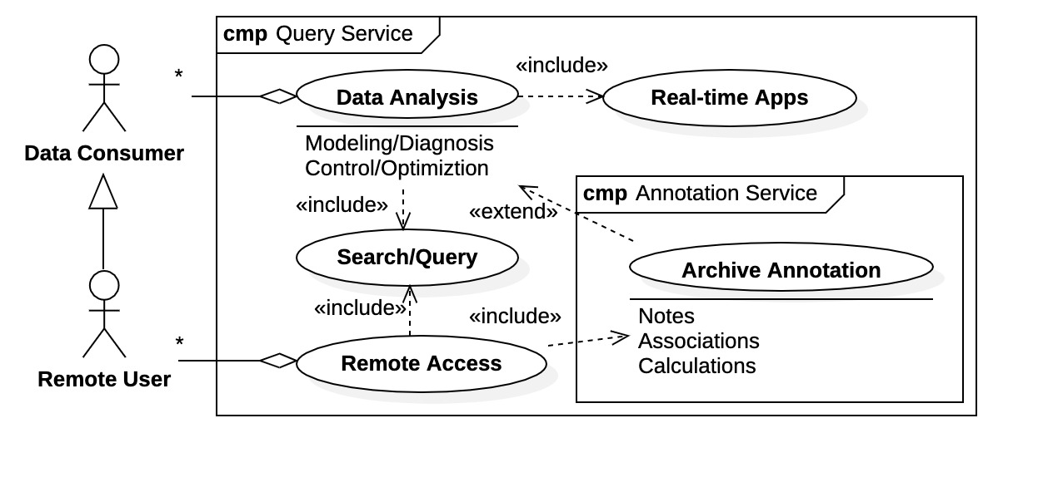
Data Platform Data Analysis Use Cases
Data Analysis with the Data Platform
Several “Query Service” components support various Data Analysis use cases.
Query Service – Interaction with DP archive
Supports data science mission of MLDP
Includes supporting components
Datastream Service (Real-time processing)
Annotation Service
Web Service
Annotation Service
Post-ingestion archive annotation by Data Consumers (notes, associations, calculations…).
Archive annotations can be queried in conjunction with archive data.
Data Consumers create “value added” data.
Web Service (not shown)
Supports Remote Access for Data Consumers.
Offers subset of Data Analysis use cases.
Use case support by the DP Query Service

Slide 19
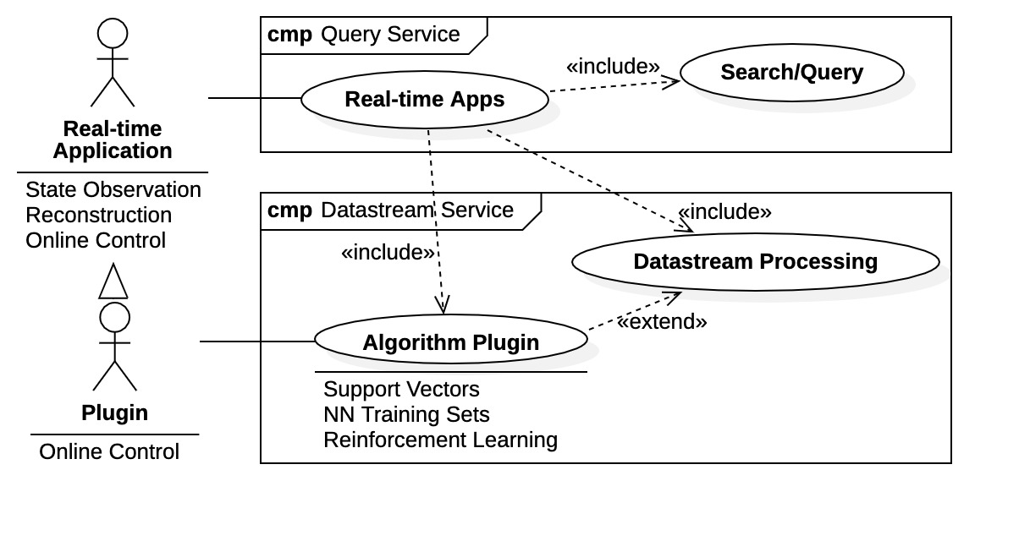
Data Platform Real-time Use Cases
Data Platform support for Data Consumer Real-time use cases.
Query Service
Objective - Search/Query performance on par with Ingestion Service (200 Mbps data query rates).
Additional direct support with Datastream Processing service includes Algorithm Plugins.*
Datastream Service*
Explicit support for real-time (online) applications.
Inline processing of ingestion data stream.
Algorithm Plugin*
Exceptional algorithms implemented as “plugins” to the datastream.
*Future Advanced Data Sciences development (Year 2)

Slide 20
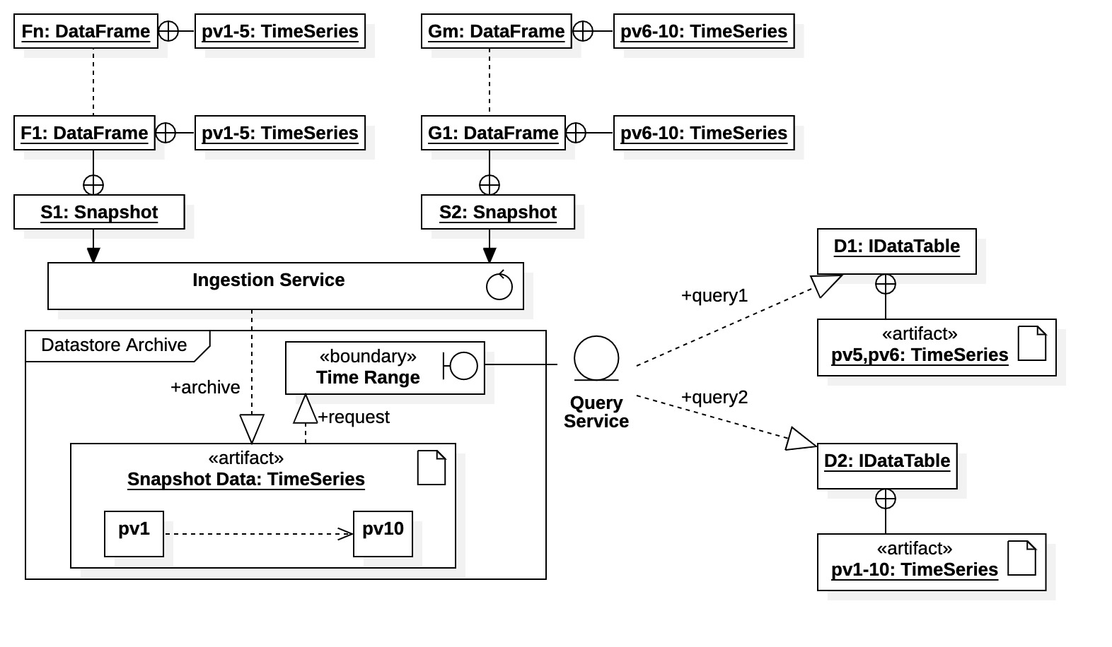
Data Platform Snapshot Data Archive
Time-series data are the primary constituent of the data archive.
Ingested as “Data Frames”. Equivalent to EPICS NTTable types.
Organized as as “Snapshots”.
Queries are available across all snapshots and data sources (PVs).
Query results are returned as dynamic data tables.

Slide 21
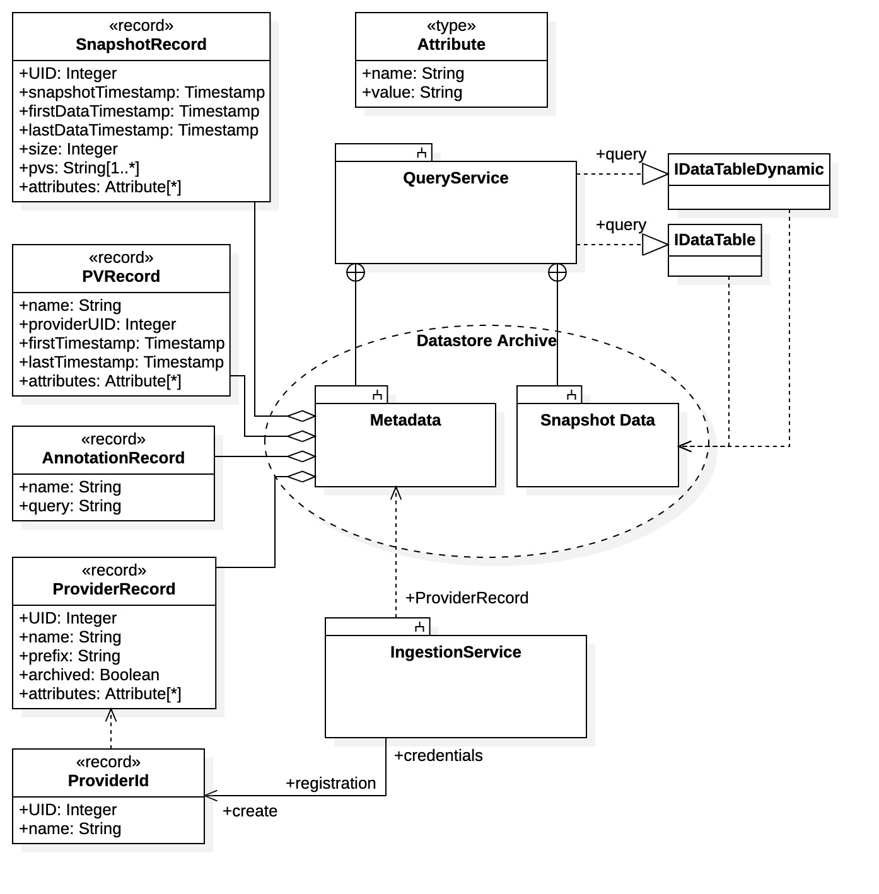
Data Platform Metadata Archive
Metadata is crucial to Data Platform operations.
Facilitates data provenance.
Snapshot data queries are available by metadata properties.
Metadata system supports archive annotation features.

Slide 22
Data Platform Communication
There are 2 communication methods with Data Platform:
Direct gRPC communications
API libraries
1. gRPC/Protocol Buffers
Data Platform has an gRPC-based communications framework utilizing Protocol Buffers for message definition.
Data Platform communications framework is defined in package dp-grpc (in “proto” meta language).
Clients must import, build, and install dp-grpc package locally.
Clients choose preferred language gRPC library.
2. API Libraries Programming language support
Ingestion Service
Java API based upon “data frame” ingestion (analogous to NTTable).
(ANTICIPATED: EPICS pvAccess interface.)
Query Service
Java API using request builders and supplying dynamic Data Tables
PLANNED: Python API based upon Pandas library.

Slide 23
DP Communications gRPC and Protobuf Background
gRPC An RPC framework (built by Google) using HTTP2 as the underlying transport mechanism.
gRPC libraries are open source and available for most programming languages and hardware platforms.
gRPC provides standard “unary” RPC calls and “data streaming” extensions.
Protocol Buffers (“Protobuf”) Defines RPC messages and interfaces using gRPC as the communications protocol.
Open source and originally developed by Google.
RPC messages and interfaces defined in “proto” meta language, then compiled into programming language.
Provides the data serialization for exchanged messages (quite efficient).
The gRPC/Protobuf communications framework facilities Data Platform standalone independence and flexibility.

Slide 24
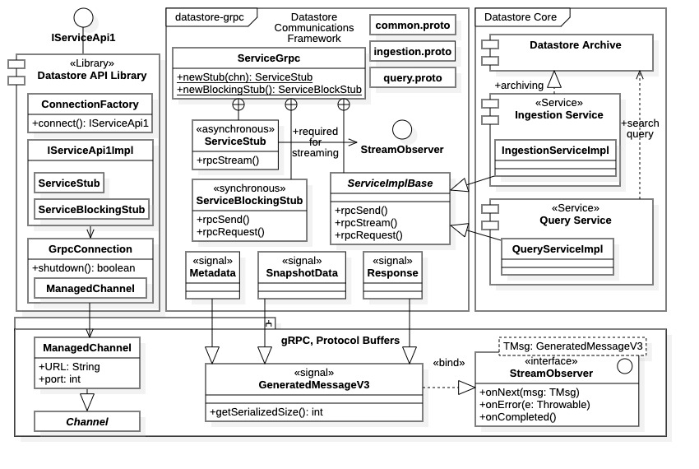
DP Communications gRPC and Protobuf
gRPC & Protobuf are sophisticated systems
gRPC
Online documentation https://grpc.io/
Development requires direct interaction with gRPC library resources.
Clients require ”Channels”; services vary.
Resources vary significantly depending upon programming language.
Protocol Buffers
Online documentation https://protobuf.dev/
Developers require familiarity with
The proto meta language.
The the protoc compiler and grpc plugin.
Java gRPC and Protobuf resources within Datastore

Slide 25
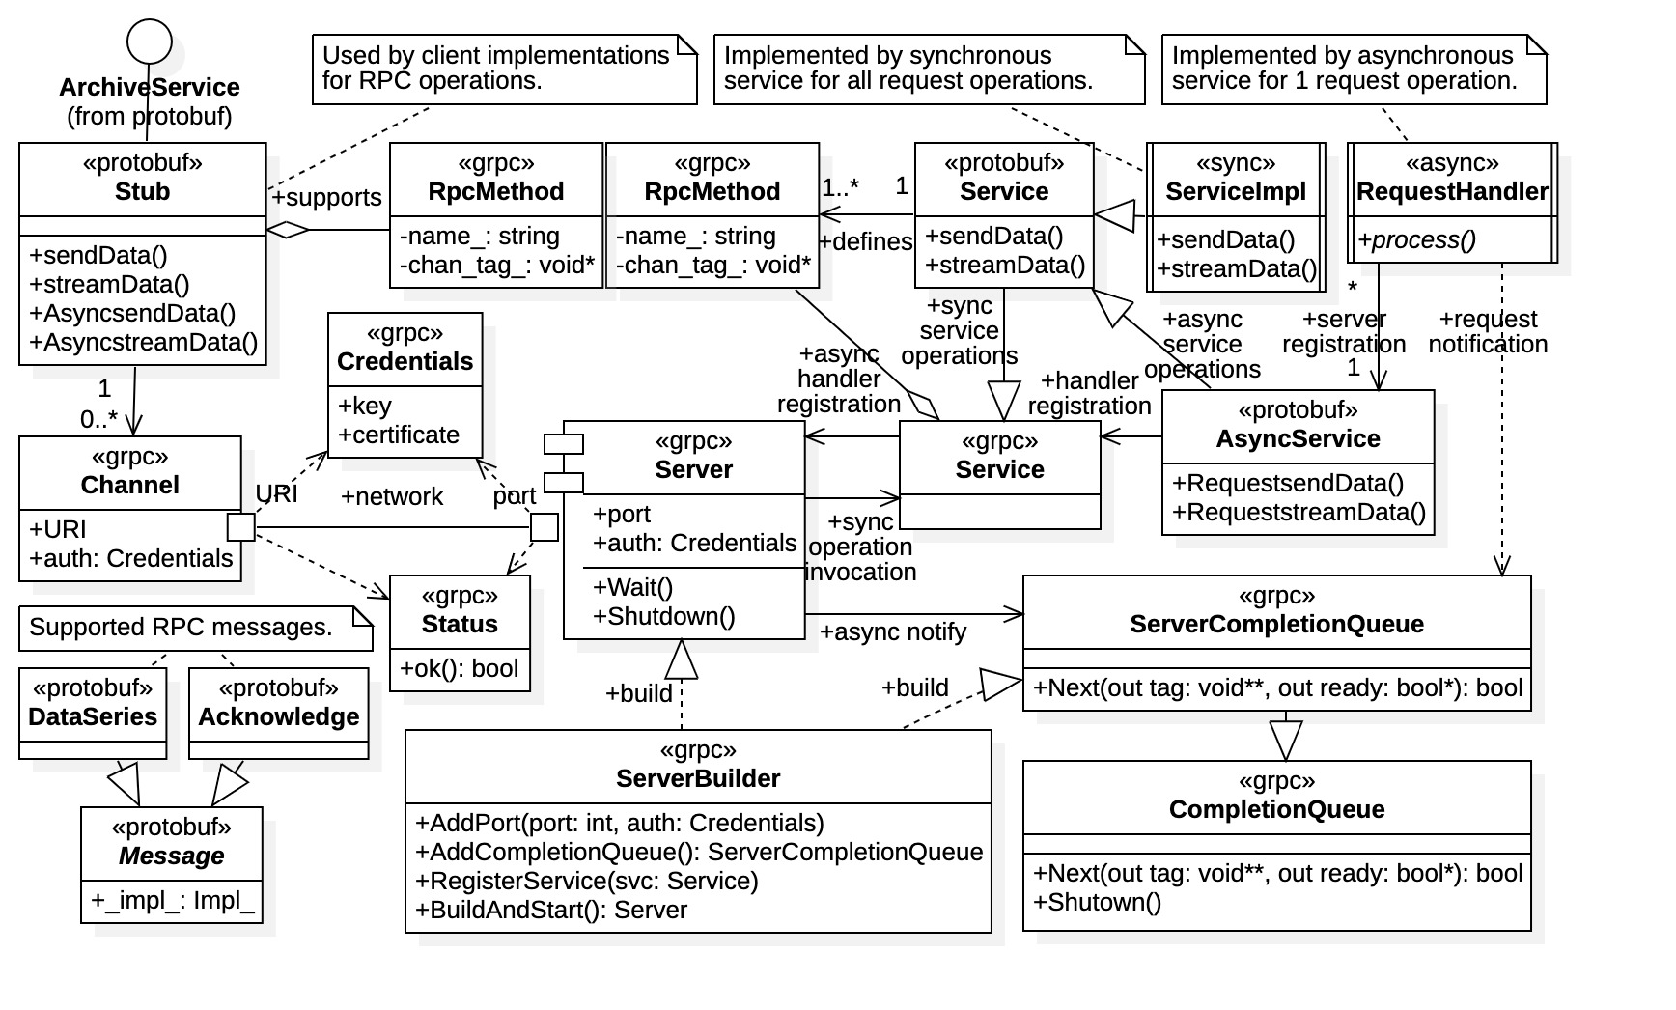
DP Communications C++ gRPC
C++ gRPC provides best gRPC transport performance seen so far.
Fine grain control.
C++ facilitates low-level access to platform.
Asynchronous, streaming transmission.
C++ gRPC development is particularly involved.
Unique from other languages (especially async impl.)
Documentation is scarce.
Fine grain control is also a requirement (lot of details).
Additional platform/environment requirements of C++.
C++ gRPC/Protobuf resources required by clients and services
C++ gRPC is attractive for specialized DP component development – datastream process, plugins, etc.

Slide 26
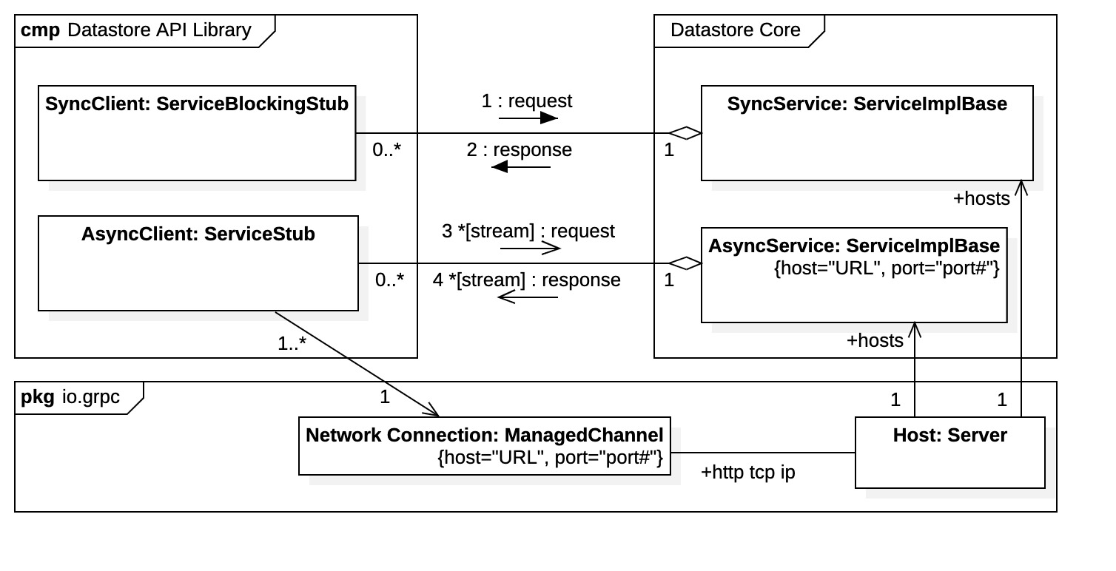
Client resources required for direct gRPC/Protobuf communications.
DP Communications
Protocol Buffers
Communication Stub – defines RPC interface.
Defined in proto and generated by protoc compiler.
Contains all client RPC endpoints.
RPC Messages – defines RPC exchange data.
Defined in proto and generated by protoc compiler.
Structure and use depend upon programming language.
gRPC
Communications Channel
Establishes network connection to service.
Establishes transmission parameters (timeout, size, …)
Required for Protobuf Communication Stub creation.
Communications stubs and communications channels.
Direct gRPC communications is complex but offers clients most comprehensive access to Data Platform.

Slide 27
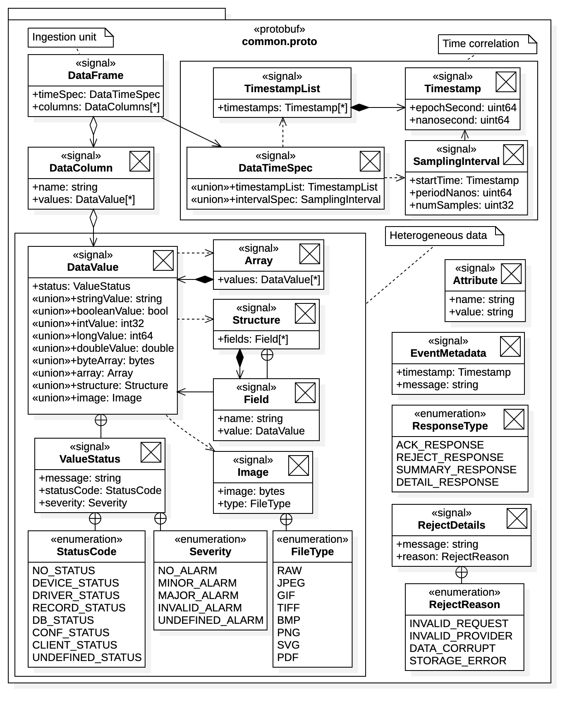
DP Communications Data Platform gRPC Framework
common.proto – Source file containing RPC messages common to both Ingestion and Query Services.
Clients populate these messages for direct RPC interaction with Data Platform.
Common Protobuf RPC messages
DataFrame – unit of ingestion.
DataValue – defines homogenous data format.
DataTimeSpec – defines timestamp specifications for DataFrame.

Slide 28
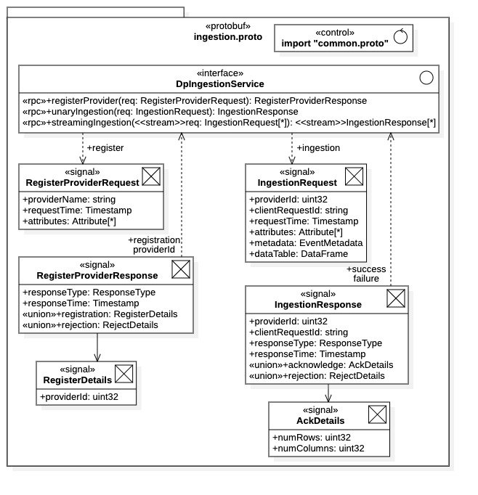
DP Communications DP gRPC Ingestion Interface
ingestion.proto – contains interface and messages specific to Ingestion Service. Used by ingestion clients (Data Providers).
DpIngestionService Interface
Data provider registration
Unary RPC data frame ingestion
Streaming gRPC data frames ingestion
RegisterProviderRequest Message
Data providers must first register with Ingestion Service before transmitting data – obtain UID.
IngestionRequest Message
Populate with DataFrame containing all or part of a snapshot.
Note inclusion of Attributes and Metadata in requests.

Slide 29
DP Communications DP gRPC Query Interface
Not Released
Still under development.
Next release.

Slide 30
DP Communications Second Method: Data Platform API Libraries
API language libraries are also available for Data Platform clients (will be available).
Client API libraries avoid the complexities of direct gRPC communications.
Offer additional features, such as default configuration, buffering, dynamic data tables, etc.
Installed locally and performance all network gRPC communications.
The Datastore prototype had 2 parallel sets of Java API libraries.
2 Ingestion APIs – A high-level library (DataFrames) and low-level gRPC wrapper.
2 Query APIs – A high-level library (Data Tables) and low-level SQL-like interface.
Currently migrating high-level Java API libraries to new platform architecture.
An additional Python query API is planned.
Based upon Pandas library common to most data science.
An EPICS pvAccess interface to the Ingestion Service is also anticipated.

Slide 31
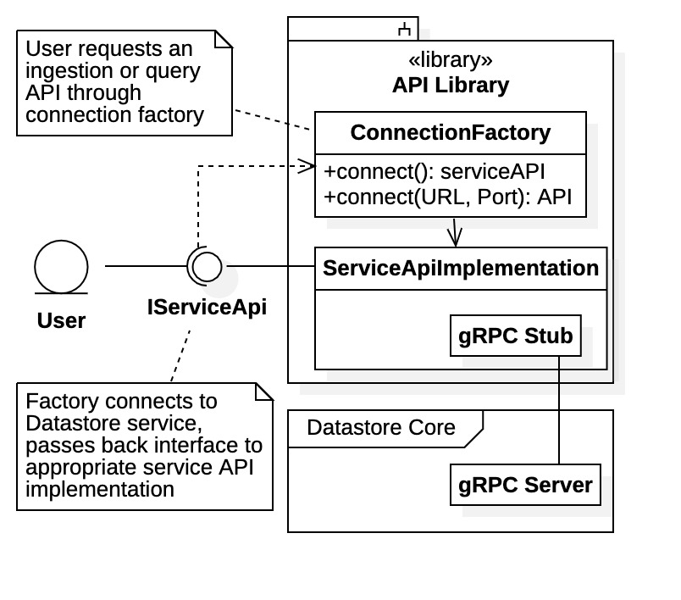
DP Communications API Library Connection Factory
Connection factories offer a standardized approach to obtaining API interfaces from an API library.
Each API library (Ingestion, Query, etc.) may have multiple Interfaces each with multiple implementations.
Specific API implementation is chosen by Connection Factory according to configuration, parameters, etc.
Allows client to specify connection target and various connection parameters.
Have default Data Platform service, or client can choose specific service URL (multiple services are available – e.g., test service).
Default connection parameters or client-specific parameters (timeout limits, compression, text/binary, etc.)
Interface Shutdown
Typically, API resources (e.g., gRPC resources) are explicitly released with a “close” or “shutdown” operation available.

Slide 32
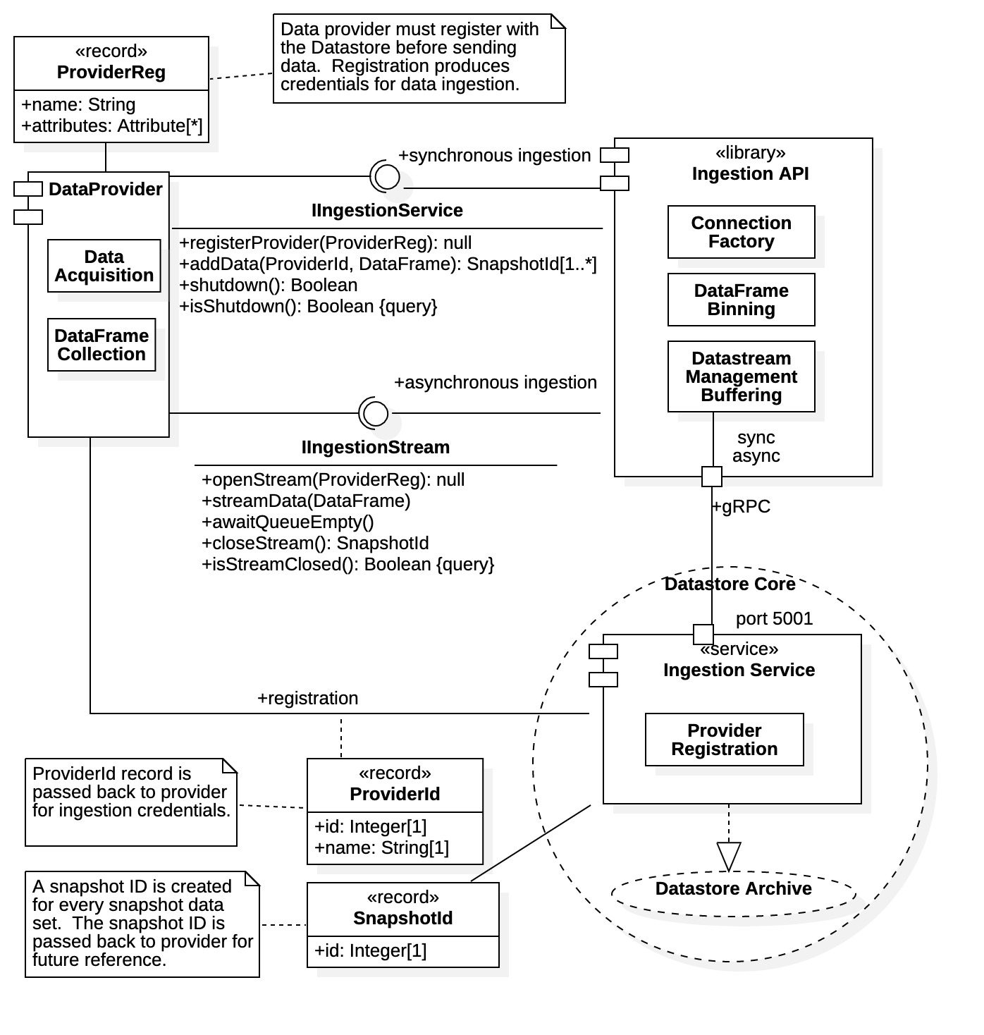
DP Communications High-Level Ingestion API
- Library Exposes 2 Interfaces - Both use data frame (NTTable) unit of ingestion
IIngestionService interface
Synchronous (blocking) ingestion
Safe, simple, single-frame ingestion
But slower
IIngestionStream interface
Non-blocking streaming ingestion
Maintains an open data stream
Maintains a buffered data queue for continuous ingestion
Registration (unique provider name)
Data providers must register with Datastore to initiate ingestion

Slide 33
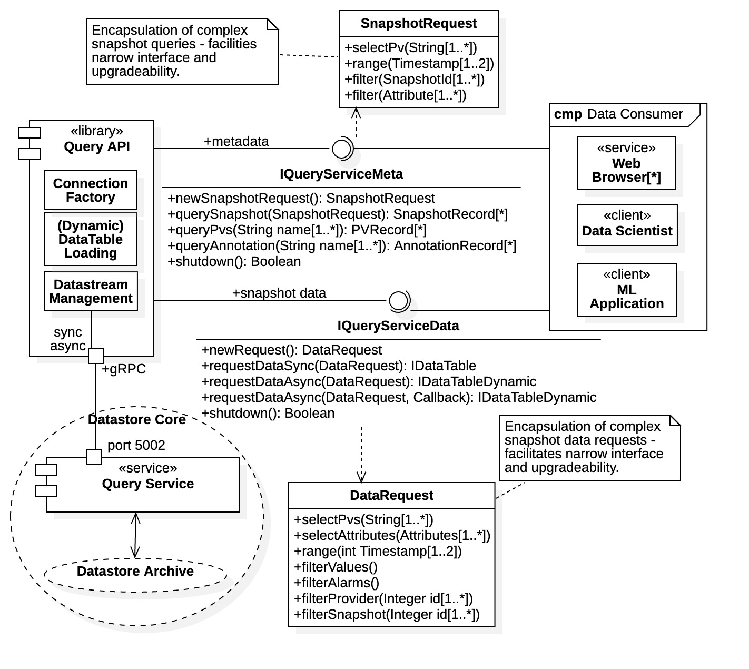
DP Communications High-Level Query API
- Library Exposes 2 Interfaces - Both use query builders
IQueryServiceMeta interface
Support metadata search and query
Uses synchronous query
Results are record sets
IQueryServiceData interface
Supports time-series search/query
Supports both synchronous and asynchronous query requests
Query builder (DataRequest)
Results are dynamic data tables

Slide 34
Data Platform Deployment
Datastore prototype has no deployment system.
Install Java (version 16 or greater)
Install and configure MongoDB and InfluxDB databases.
Users must clone (3 to 7) Github repositories, build, install locally, configure, and explicitly start services.
Data Platform has a formal deployment system.
Must install Java and MongoDB locally.
https://github.com/osprey-dcs/data-platform
Download installation archive from repository and unzip.
Scripts are available for Data Platform service startups.
There are explicit instructions and documentation for all.
Data Platform is currently in development!
NOTE: Moving target – Even gRPC API is changing!
Latest (pre-)releases are available for inspection.
Current release has working Ingestion Service.

Slide 35
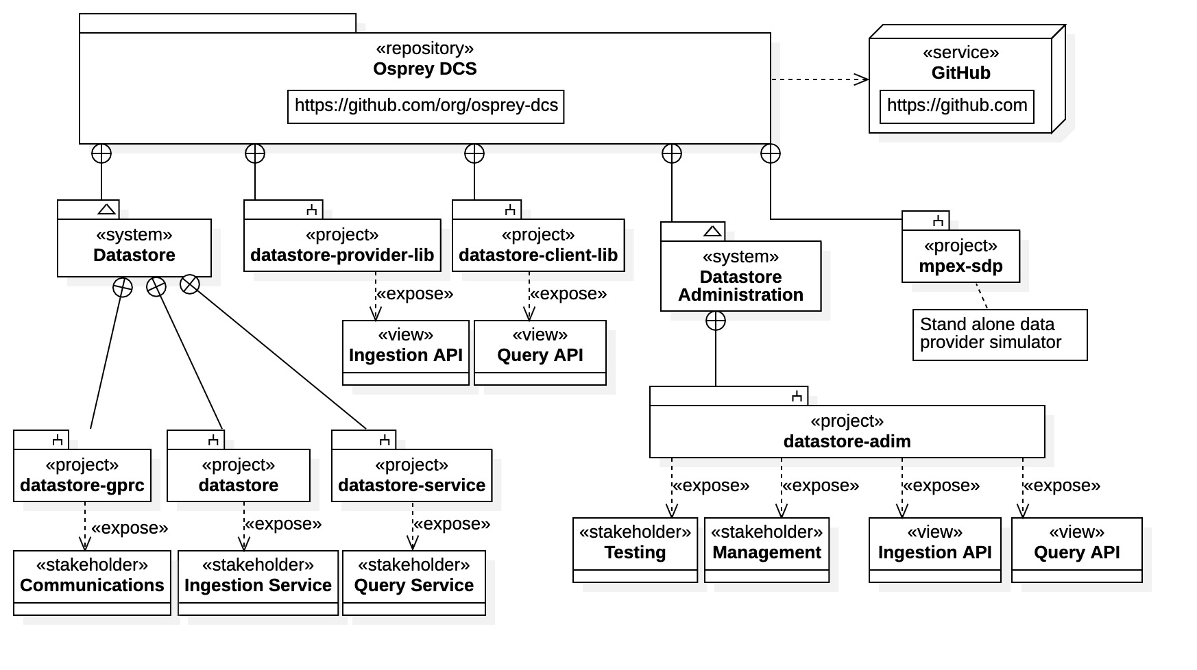
DP Deployment Previous Installation Process (Datastore prototype)
Complicated.

Slide 36
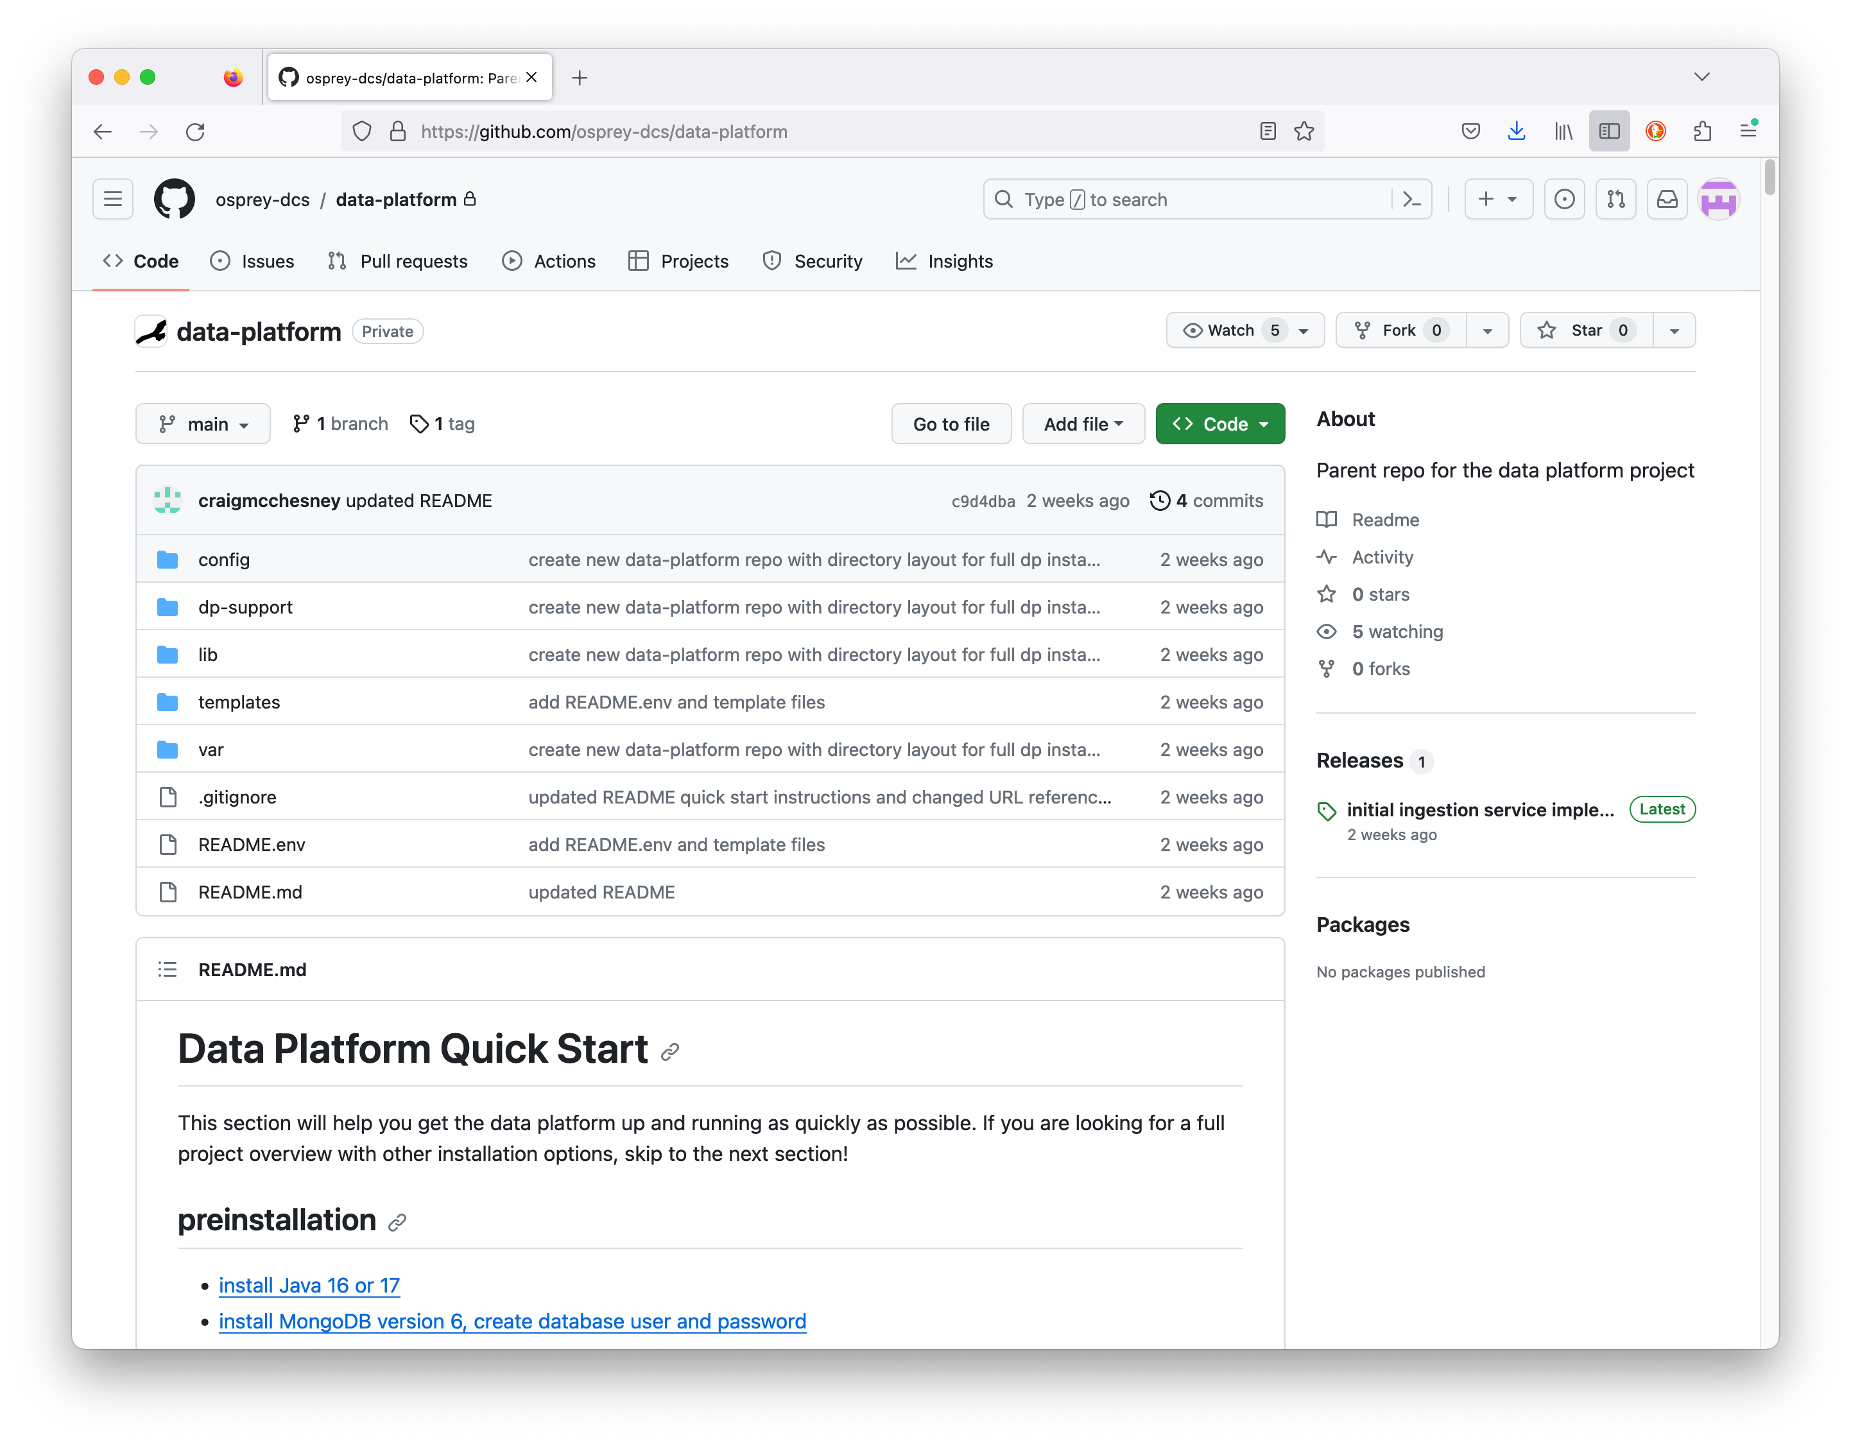
DP Deployment Installation Repository
https://github.com/osprey-dcs/data-platform
Installation distributed as a zipped archive.
Download and unzip into local installation directory.
Services deployed as Java “fat jars”.
Services are started with scripts.
located in expanded dp-support directory.
Process is well documented.
See Github repository page.
Instructions/documentation
data-platform-installer.tar.gz - Download and unzip.

Slide 37
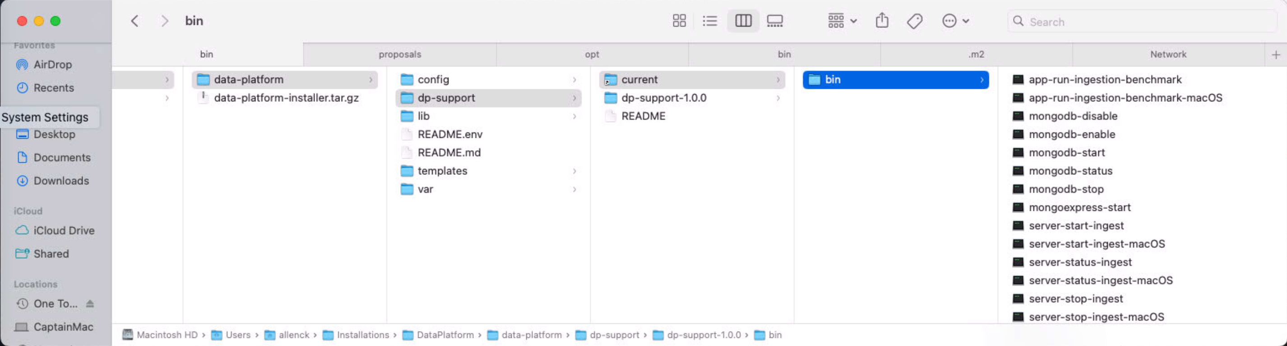
DP Deployment DP Service Startup
1. Set Data Platform installation location (tell Data Platform where it is).
Create .dp.env file in home directory specifying install location.
Include following line (replace `~/data-platform’ with install path) export DP_HOME=~/data-platform
Or set DP_HOME directly in your profile.
2. Startup scripts are available within installation.
~/data-platform/dp-support/current/bin
Also have scripts to start/shutdown MongoDB
Installation location (expanded archive)
Service localization
Script location
Downloaded installer archive
Ingestion Service startup

Slide 38
DP Deployment Current Release
Recall: Must install Java (version 16 or greater) and MongoDB (free Community Edition)
Instructions are available at https://github.com/osprey-dcs/data-platform
Must create a MongoDB administrative account (identified in dp-ingest.yml)
Data Platform Communications
gRPC interface only.
Ingestion Service
Operational with basic functionality.
Localization/configuration in ~/data-platform/config/dp-ingest.yml
Query Service
Next Release.

Slide 39
Summary
The Data Platform is a standalone subsystem of the larger Machine Learning Data Platform (MLDP).
Management of heterogenous data with focus on data science.
A working prototype was initially developed – “Datastore”.
A new, performance-based version is currently under development – “Data Platform”.
Data Platform has multiple components supporting use cases as collaborating services (with well-defined APIs).
Data Platform has 2 communication methods.
Direct gRPC communications (download and install dp-grpc)
Client API libraries for Java and Python (future).
A deployment system is available for latest DP releases.
Ingestion Service is operational (and fast).
Basic Query Service is nearly operational.
Only direct gRPC communication is currently available.

Slide 40

Supplemental

Slide 41
Data Platform Use Cases Actors are generally divided into Data Providers Data Consumers
Data Acquisition and Ingestion
Aggregator
Actors here are hardware systems
Collection, alignment, and staging (synchronous acquisition)
Ingestion Service
Actors are Data Providers
The Aggregator subsystem is one Data Provider
Data Providers conform to Ingestion API

Slide 42
Ingestion APIs
API libraries connect to the Datastore Ingestion Service (server) via gRPC
2 Ingestion Libraries
datastore-provider-lib – (original) wide interface using Java native types
Very general, but complex, interface
“Snapshot” unit of ingestion (abstract)
datastore-admin - (new) narrow interface based upon “data frame”
data frame – concrete unit of ingestion (timestamps and data columns)
EPICS oriented – data frame is analogous to EPICS NTTable

Slide 43
Query APIs
API libraries connect to the Datastore Query Service (server) via gRPC
2 Query Libraries
datastore-client-lib (original) wide interface – developer oriented
Queries are made using “Datastore Query Language” (DQL)
Must be familiar with some Datastore gRPC messages
datastore-admin – (new) narrow interface – data science oriented
Queries are made using a query builder
Results are returned as records (metadata) and data tables (time-series)
Future – A Python language query API is planned for development
Support for the Pandas DataFrame object

Slide 44
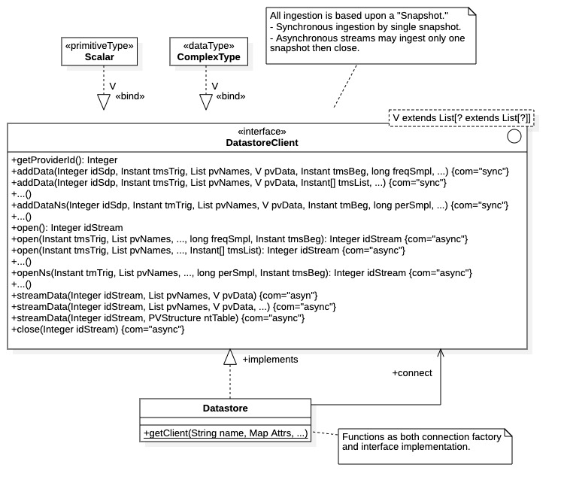
Original Ingestion API datastore-provider-lib project - “Snapshot” unit of ingestion
DatastoreClient interface
Wide interface for Java native types
“Snapshot” unit of ingestion - abstract
By start time and sampling freq/period
By timestamp list
Snapshot contains one data type
Synchronous (blocking) ingestion
addData() operations
Safe, simple, snapshot ingestion (slow)
Asynchronous (non-blocking) ingestion
open(), streamData(), close() operations
Open stream, send 1 snapshot, then close
There are multiple method signatures for all

Slide 45
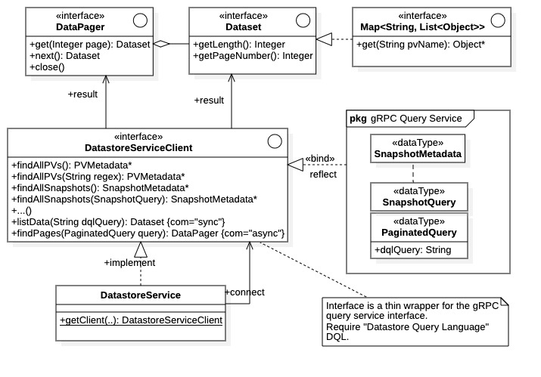
Original Query API datastore-client-lib project Datastore Query Language (DQL)
DatastoreServiceClient interface
Metadata search/query
Synchronous results are gRPC messages
Time-series search/query
Synchronous results as Dataset
4 Mbyte limit
Asynchronous results as DataPager
Queries as Datastore Query Language (DQL)
SQL-like query string
Asynch. request packaged in gRPC message PaginatedQuery

Slide 46
Datastore Query Language (DQL)
Supplemental
SQL-like query language used to make time-series data requests from Datastore
SELECT <source>, <source>, … WHERE <time-predicate> AND <sub-predicate> <AND> …
<source> := data sources and properties (EPICS PVs, alarm conditions, etc.)
<time-predicate> := specifies time range of query
<sub-predicate> := additional conditionals on query (filters, etc.)
All predicate clauses have the form <predicate> := <parameter> <operator> <value>
Examples:
SELECT Cam1-Image, `BPM-*.*` WHERE time >= ‘2022-10-01T01:23:45Z’ AND BPM-15.value > 10
SELECT `PV*.*` WHERE time > -5h AND PV01.value < 0 AND `PV02:alarm-severity` == ‘MAJOR_ALARM’

Slide 47
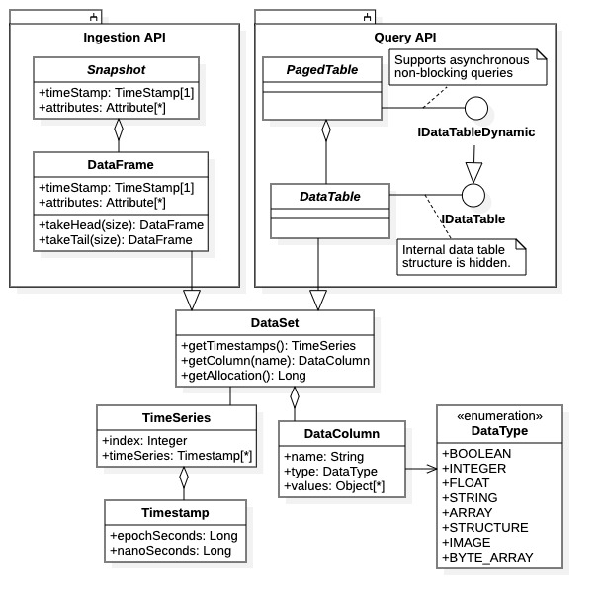
DataFrames and DataTables (New API Libraries)
Supplemental
Both tables of heterogeneous, time-series data
Column of timestamps
Columns of data (each column may be different data type)
DataFrame are for Ingestion (“ingestion unit”)
Concrete: Contains both time-series data and metadata information
Allows “binning” for gRPC size limitations
DataTable are for Query (contains result sets)
Abstract thru interfaces, e.g., IDataTable
Implementation depends upon request type

Slide 48
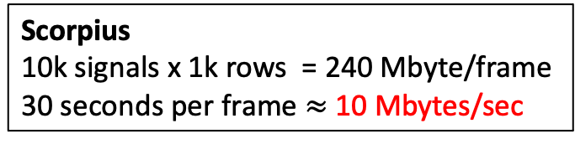
Datastore Performance
Scorpius
10k signals x 1k rows = 240 Mbyte/frame
30 seconds per frame $≈$ 10 Mbytes/sec
Target Ingestion Data Rate
Stated Goal: 4,000 signals at 1 kHz sampling
After aggregation: [1,000 row X 4,000 col] data frame/second
Native implementation (8 bytes/float) = 32 Mbytes/second
Java Implementation (24 bytes/Double) = 96 Mbytes/second
100 Mbytes/second Target Data Rates for both Ingestion and Query

Slide 49
Performance Evaluations Test Platforms
Single-node
2.7 GHz clock
6 to 10 Cores
16 – 32 GBytes RAM
Network loopback
(expect a factor ~10 increase with dedicated hardware)
Ingestion and query evaluations platform configuration

Slide 50
Datastore Ingestion Performance – Data Rates Wide Scalar Frames (e.g., Data Frames from Aggregator)
CASES:
100 columns Boolean/Integer/Double/String values; 100 rows; 370 Kbyte frames
500 columns of Double values; 500 rows; 6 Mbyte frames
500 columns of Strings (avg. 60 chars); 500 rows; 41 Mbyte frames (avg.)
1,000 columns of Double values; 1,000 rows; 24 Mbyte frames
2,000 columns of Double values; 1,000 rows; 48 Mbyte frames
Continuous, sustained ingestion (multi-frame)
Case | Scenario Name | Frame size each (Mbytes) | Synchronous rate (Mbytes/sec) | Asynchronous rate (Mbytes/sec)
1 (100 cols) | SMALL_TABLES | 0.370 | 0.046 | 0.178
2 (500 cols) | MODEST_TABLES | 6 | 0.107 | 0.206
3 (500 cols) | STRING_TABLES | 41 | 0.103 | 1.00*
4 (1k cols) | LARGE_TABLES | 24 | 0.061 | 0.143
5 (2k cols) | HUGE_TABLES | 48 | 0.037 | 0.256
*Interesting anomalous value for strings

Slide 51
Datastore Ingestion Performance - Data Rates Arrays, Data Structures, Images*
*All use a different archiving technique than that for scalars
Continuous, sustained ingestion (multi-frame)
Case | Scenario Name | Frame size each (Mbytes) | Synchronous rate (Mbytes/sec) | Asynchronous rate (Mbytes/sec)
1 (arrays) | LARGE_ARRAYS | 3.8 | 2.39 | 5.7
2 (structures) | LARGE_STRUCTURES | 8.9 | 2.03 | 48.2*
3 (images) | LARGE_IMAGES | 26 | 4.6 | 5.35
CASES:
10 cols 38 Kbyte arrays; 10 rows; 3.8 Mbyte frames
10 cols 82 Kbyte data structures; 10 rows; 8.9 Mbyte frames
10 cols 260 Kbyte images; 10 rows; 26 Mbyte frames
*Datastore Ingestion Service archiving error
Approximate factor 20 performance increase over wide data frames (due to metadata processing)

Slide 52
Datastore Query Performance - Data Rates Wide Scalar Tables
CASES
500 columns of random double values; 100 rows
1 Frame (1.2 Mbytes request)
10 Frames (12 Mbytes request)
1,000 columns of random double values; 100 rows
1 Frame. (2.4 Mbytes request)
10 Frames (24 Mbytes request)
2,000 columns of random double values; 100 rows
1 Frame (4.8 Mbytes request)
10 Frames (48 Mbytes request)
Case | Frame Count | Result Size (Mbytes) | Synch. Rate (Mbytes/sec) | Async. Rate (Mbytes/sec) | Async. Callback (Mbytes/sec)
1) 500 Columns | 1 | 1.202 | 0.5927 | 2.018 | 1.945
 | 10 | 12.02 | * | 1.632 | 1.972
2) 1k Columns | 1 | 2.402 | 1.590 | 2.152 | 2.192
 | 10 | 24.02 | * | 1.811 | 1.896
3) 2k Columns | 1 | 4.802 | * | 2.057 | 1.874
 | 10 | 48.02 | * | 1.670 | 1.427
*Synchronous requests unavailable due to 4 Mbyte gRPC message size limit

Slide 53
Datastore Query Performance – Query Times and Scaling Network Transmission and Processing Time (Narrow Scalar Tables – 64 cols)
Decompose total query times into network transmission and resulting data processing
Query result sets vary from 64K to 6.4M bytes
Network transmission time with Datastore gRPC communications framework
Total query time includes processing within Datastore Query Service

Slide 54
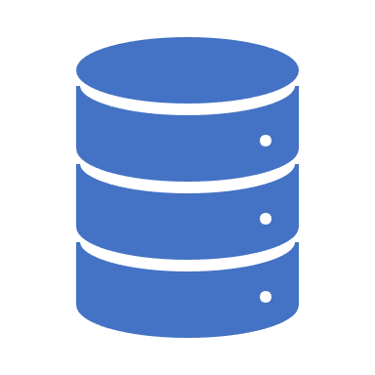
Summary
Datastore is a standalone system within the MLDP
Any facility may use Datastore archive
Data Providers - conform to an Ingestion API
Data Consumer - Data mgt, search, and query backend available
Two parallel sets of Ingestion and Query API libraries
Available: Wide, general-purpose for both ingestion and query
Available: Narrow APIs supporting “data frame” ingestion and data science query (i.e., result tables)
Planned: Python query API supporting Pandas DataFrame
Datastore Performance requires improvement for stated goals
Ingestion data rates by a factor > 100
Query data rates by a factor 50

